Slide 1








IEEE, KSV
STUDENT BRANCH
Track Number: 03
Track Title: Technology for Social Good & Sustainable Progress
PROBLEM STATEMENT:
The rising elderly population faces challenges in health management, emotional well-being, and timely support, while current fragmented elder-care systems hinder usability. A unified, user-friendly platform is needed to ensure safety, independence, and continuous support.
Video Link: https://drive.google.com/file/d/1Ye6ZOEtAlA9Fjl3nDeZA9UMmdQpFrrhT/view?usp=drive_link
Team ID: ID_38_GREENSYNC
Team Name: GREENSYNC
Institute Name: Vidush Somany Institute of Technology and Research

Slide 2



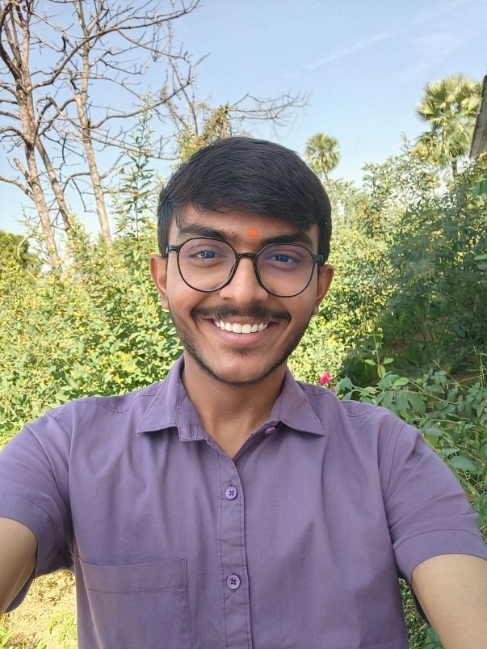
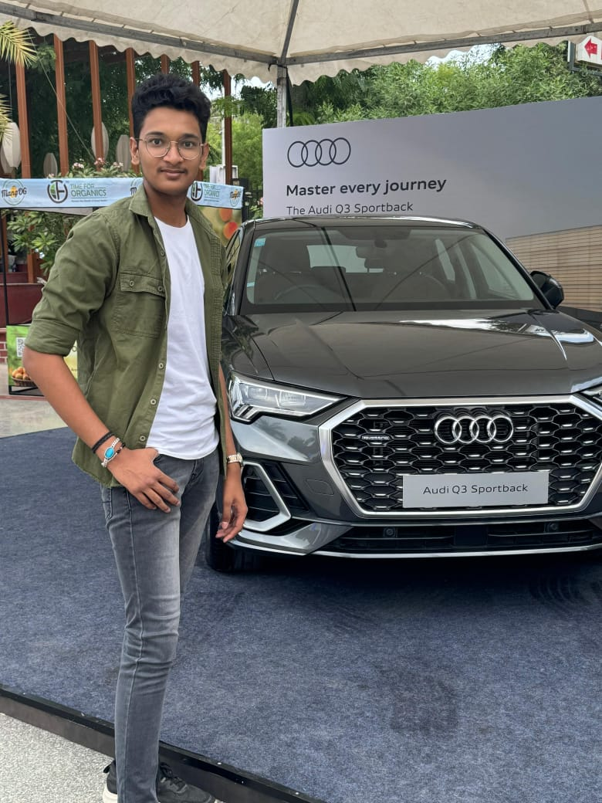
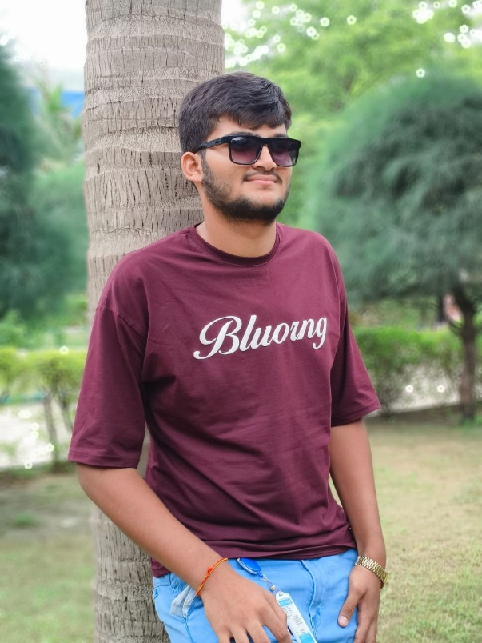
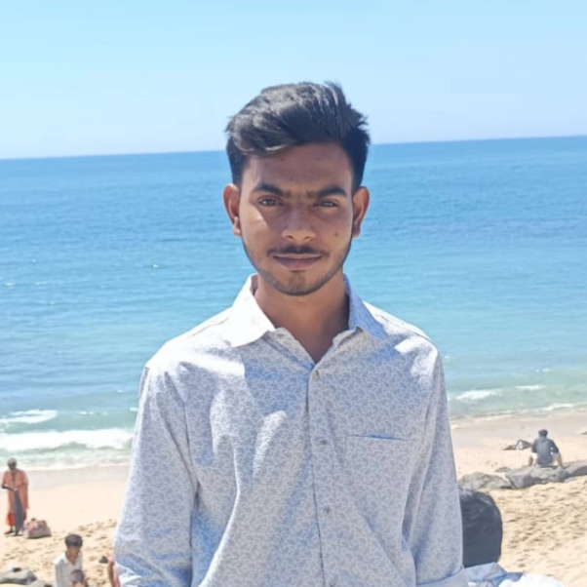
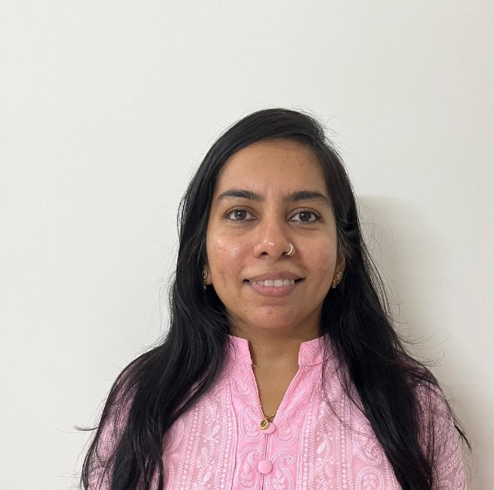

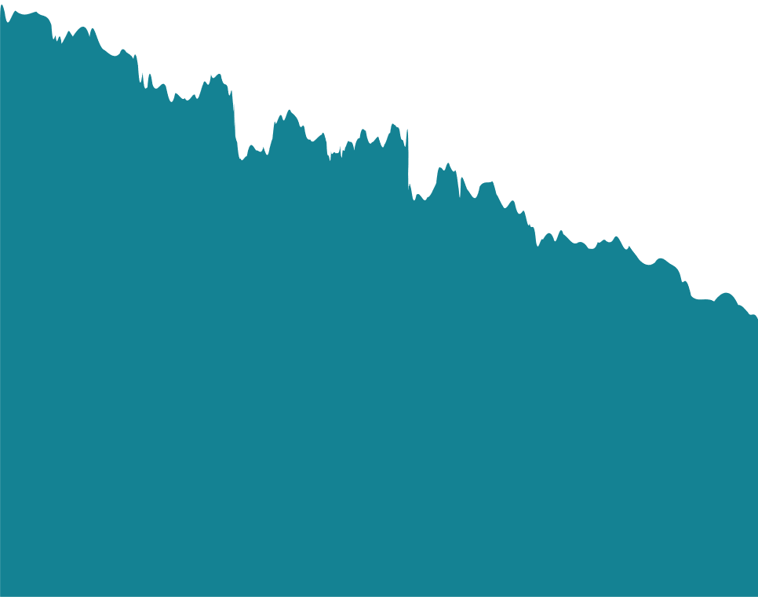
TEAM DETAILS
Patel Ved .A
Vyas Jenil .N
Vekariya Jeel .N
Vaghela Jaymeen .N
Parita Vishal Shah
Team Leader
Co-Team Leader
Team Member
Team Member
Guide
24BEIT54026
Information Technology, VSITR, KSV
24BECSE54050
Computer Science and Engineering,
VSITR, KSV
24BECE54041
Computer Engineering, VSITR, KSV
24BECE54039
Computer Engineering, VSITR, KSV
Computer Engineering, VSITR, KSV
2

Slide 3

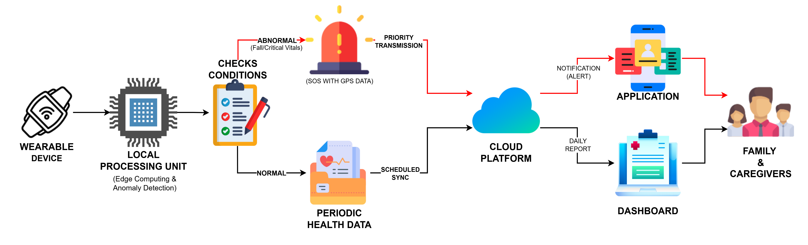
IDEA DETAILS
Proposed Solution: Vrudhseva Work-Flow
Vrudhseva is a wearable IoT-based system designed to monitor elderly health and activity while providing instant alerts during emergencies.
✨ Unique Features
Automatic Emergency Detection (Hands-Free SOS).
Priority-Based Alert Mechanism (SOS).
Real-Time Location Sharing During Emergencies.
Virtual Assistant (as a companion for Elders).
Elder Emotion Reassurance Notifications.
Family centric by design.
Elderly-Friendly Wearable Design (Lightweight & soft-strap for sensitive skin).
3

Slide 4
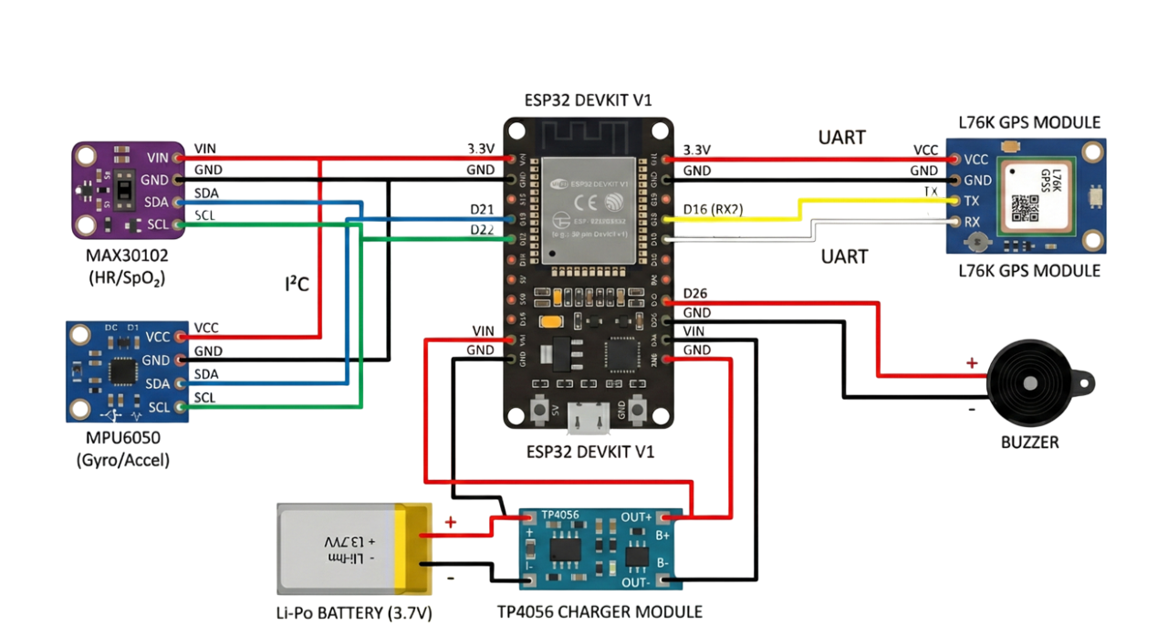










TECHNICAL APPROACH
Technologies:
ESP32/ESP32-C3
Component | Model | Function | Parameters | Reason for Selection
Microcontroller | ESP32/ ESP32-C3 | Central controller | Wi-Fi + BLE, low power modes | Handles sensor fusion, alerts & cloud communication
Heart Rate & SpO₂ Sensor | MAX30102 | Measures heart rate & blood oxygen | HR (30–240 BPM), SpO₂ (70–100%) | Non-invasive, Industry-accepted PPG sensor
Motion Sensor (IMU) | MPU6050 | Fall detection & activity tracking | 3-axis accelerometer + gyroscope | Reliable fall detection & motion analysis
GPS Module | L76K | Location tracking during emergencies | 2.5–5 m accuracy, ultra-low power | Wearable-optimized GPS for SOS
Battery | Li-Po (500–1000 mAh) | Power supply | Rechargeable, compact | Long battery life for continuous monitoring
Buzzer / Vibration Motor | Mini Buzzer / Motor | Audio / haptic alerts | Low power | Provides immediate user feedback
Enclosure Material | Medical-grade Silicone | Wearable casing | Hypoallergenic, soft | Safe & comfortable for elderly skin
Tech Stack:
Mobile Interface
Presentation Layer
Secure Gateway & auth
API Gateway Layer
Health Monitoring Logic
Business Logic Layer
Sensor data & caching
Data & Storage Layer
Wearable & Notification
IOT Integration Layer
4

Slide 5
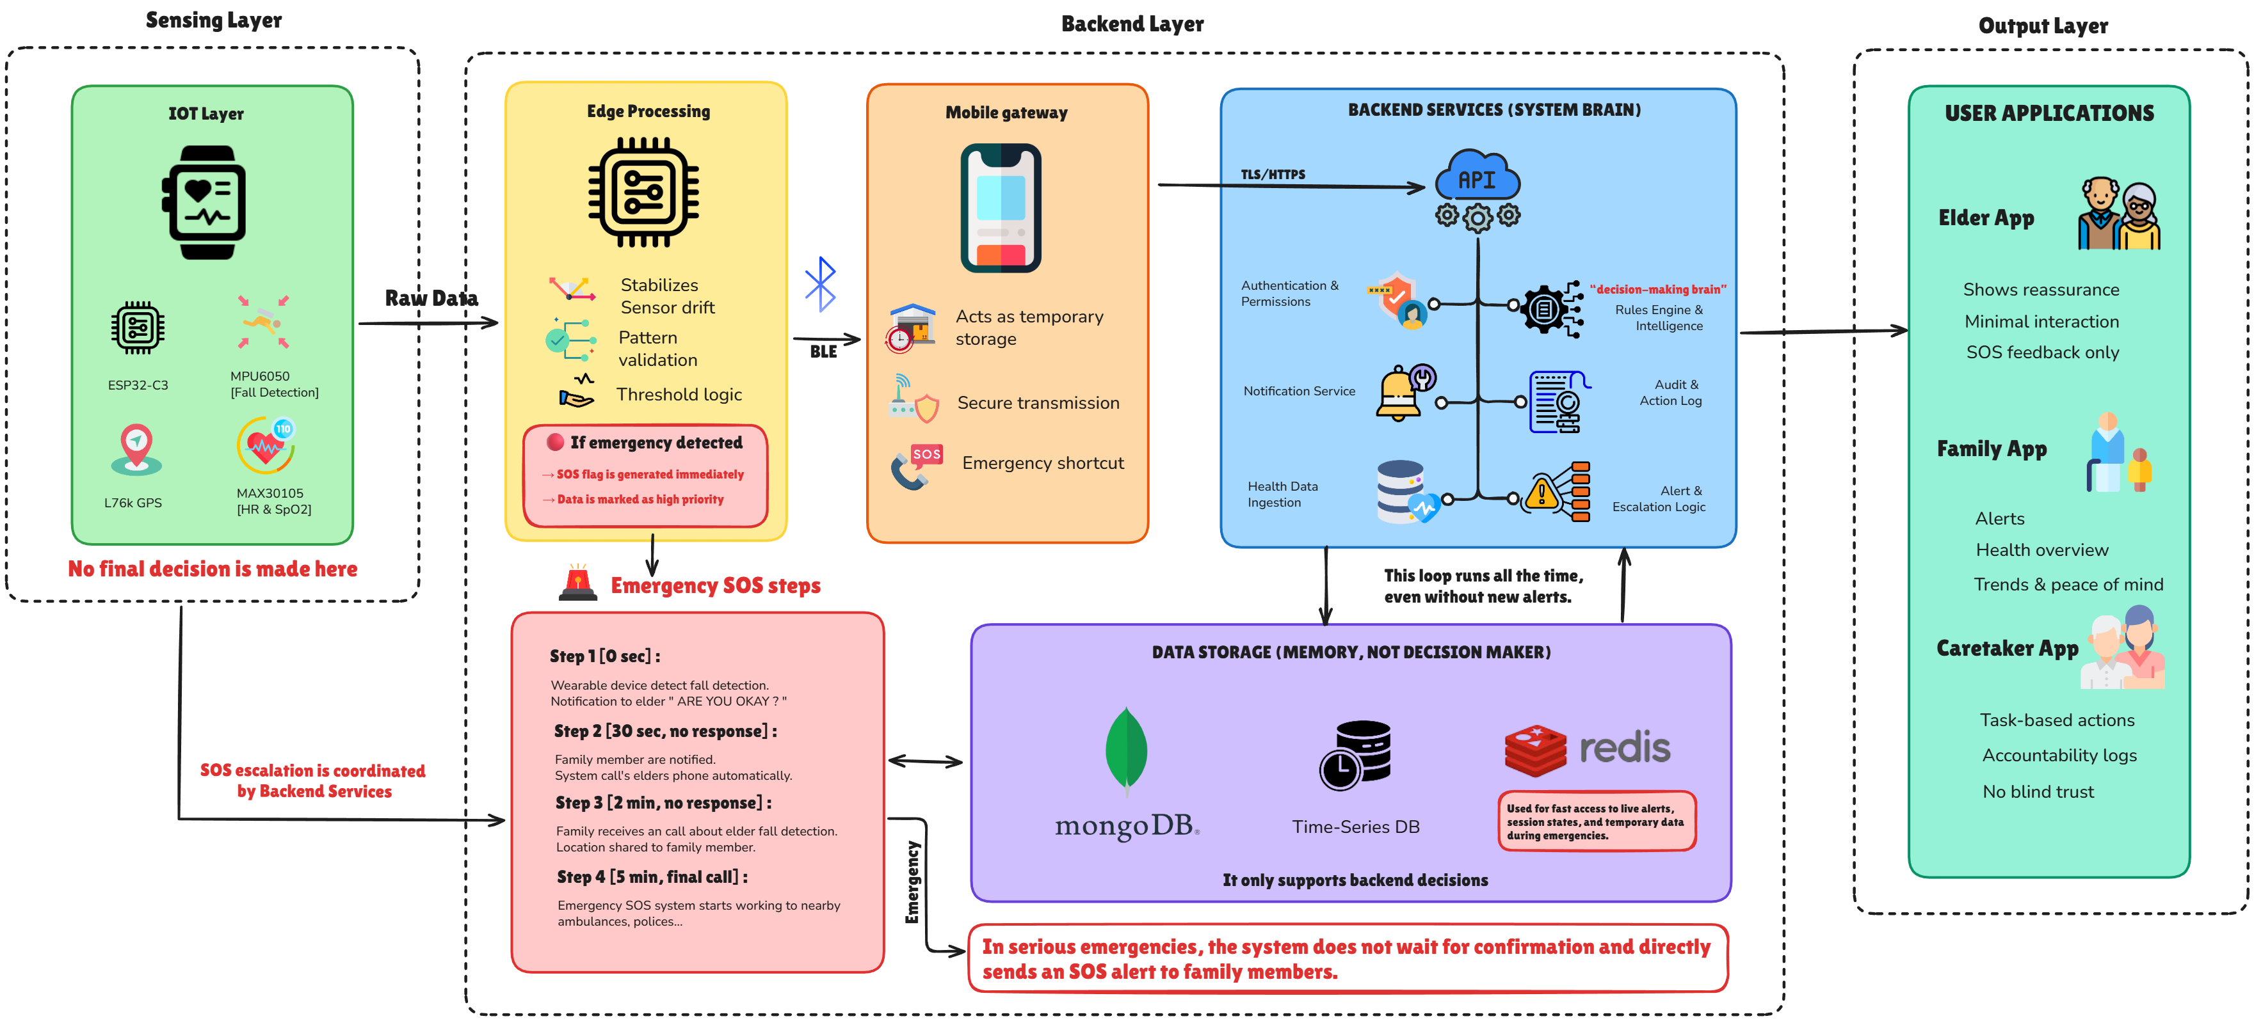

ARCHITECTURE
Vrudhseva – Elderly Care Platform
5

Slide 6
FEASIBILITY AND VIABILITY
Feasibility
Challenges
Mitigation Steps
Technical:
Sensor accuracy variations due to improper wearing, loose contact, or sensitive elderly skin conditions.
The system uses a secure wrist-worn design with automatic calibration to ensure reliable sensor contact.
System uses readily available IoT components usings protocols like I²C and UART.
Automatic emergency detection logic implemented using sensor thresholds and activity patterns.
Motion noise and signal artifacts affecting heart rate and SpO₂ readings during movement.
Motion data is used to reduce noise in heart rate and SpO₂ readings during movement.
Operational:
False emergency alerts caused by sudden but non-critical movements such as sitting quickly or tremors
The system verifies emergencies by analyzing falls, vital signs, and inactivity before sending alerts.
Designed for users with limited mobility, cognitive decline, or motor disabilities.
Wearable form factor ensures continuous monitoring without daily setup.
Limited GPS accuracy indoors and adaptation Challenges for Elderly Users
Emergency location is shared using assisted positioning, with the system operating automatically for elderly users.
Financial:
Uses low-cost, mass-produced electronic components ,hence making it cost effective.
Scalable cloud infrastructure ensures costs grow proportionally with user adoption.
Elderly users with vision or digital limitations struggle to use technology, manage reminders, and stay emotionally supported.
A voice-based virtual assistant delivering guidance, reminders, health updates, and companionship to support independent aging.
6

Slide 7
IMPACT AND BENEFITS
Impacts on elders
Enables independent living without constant supervision
Reduces social isolation anxiety by ensuring someone is always reachable
Elders benefit from technology without needing to learn or adapt to complex systems.
Social benefits
Improves the quality of life index for senior citizens.
Reduces burden on hospitals and emergency services through early detection
Encourages a preventive healthcare culture over reactive treatment
Impact on Family Members
Provides real-time alerts during emergencies and Improves response time in critical situations
Enables remote monitoring of elderly well-being also Reduces stress due to physical distance.
Helps family members manage professional responsibilities and caregiving more effectively.
Economic Benefits
Reduces Financial Burden on Families by Preventing unexpected emergency expenses through early intervention.
Optimized use of healthcare resources and infrastructure.
Reduced hospitalization and emergency treatment costs.
Benefits
Impact
Market Opportunity & Adoption Benefits:
India will have 150+ million elderly citizens by 2030, creating strong and sustained demand.
India is among the top 3 countries globally in wearable & digital health adoption, ensuring readiness.
Rising chronic illnesses and independent living among elders create high need for continuous monitoring.
Impact on Caregivers
Supports timely intervention during abnormal events
Enables better coordination with family members
Simplifies monitoring of multiple elderly users simultaneously
Reduces Caregiver Stress and Burnout
6

Slide 8









COMPARISON WITH EXISTING SYSTEM
Why Vrudhseva Is Fundamentally Different
Feature / Capability | Philips Lifeline | CarePredict | Anvayaa (India) | Vrudhseva
Works without elder interaction
Automatic fall detection
Context-aware Emergency SOS
Skips verification in critical cases
Continuous health monitoring
Backend decision intelligence
Family + caretaker role control
Caretaker accountability tracking
Designed for Indian family dynamics
Elder dignity-first design
Offline / low-connectivity handling
Privacy & consent transparency
Existing elder-care platforms solve isolated problems such as fall alerts, emergency calling, or service coordination. However, real-life elder emergencies are unpredictable, silent, and often unattended.
Vrudhseva’s Core Philosophy: -
Designed as an invisible safety layer, not an app that demands attention.
Assumes the elder may be unconscious, confused, or unable to respond.
Decisions are system-driven, not user-driven.
Intelligence Over Interaction: -
Health signals are continuously evaluated, not checked on demand.
The system understands severity, trend, and urgency, not just thresholds.
Critical conditions can override normal verification flows to save time.
Family-Centric by Design: -
Built around Indian family dynamics, where multiple stakeholders are involved.
Clear separation of family visibility and caretaker responsibility.
Prevents emotional burden on elders by reducing unnecessary alerts.
Trust, Accountability & Continuity: -
Every action in the system is traceable and auditable.
Works even in low-connectivity or offline conditions.
Privacy and consent are treated as system rules, not optional settings.
Reference: -
Stavropoulos et al., IoT Wearable Sensors and Devices in Elderly Care, Sensors, 2020.
Durán-Vega et al., IoT System for Remote Health Monitoring in Elderly Adults, Sensors, 2019.
To know more in detail, please visit the given drive link and refer to the complete PRD document.
Link: - https://drive.google.com/drive/folders/1Yif75c6HXB7Bj48IkXc1G9QEZXrq-ffI?usp=sharing
8

